Slide 1
Assignment No.02
Shell Scripting
Name:Naikade Rohit Anand.

Slide 2
Fetch status of host up/down.
Firstly,we can fetch all the connected hosts on network using hostname -I command.
-I does not depend on resolvability of hostname.
then,by using ping command,we can fetch status of ip address,whether its running or down.
Syntax:ping -c -W1 ip_address
Notes:
‹#›

Slide 3
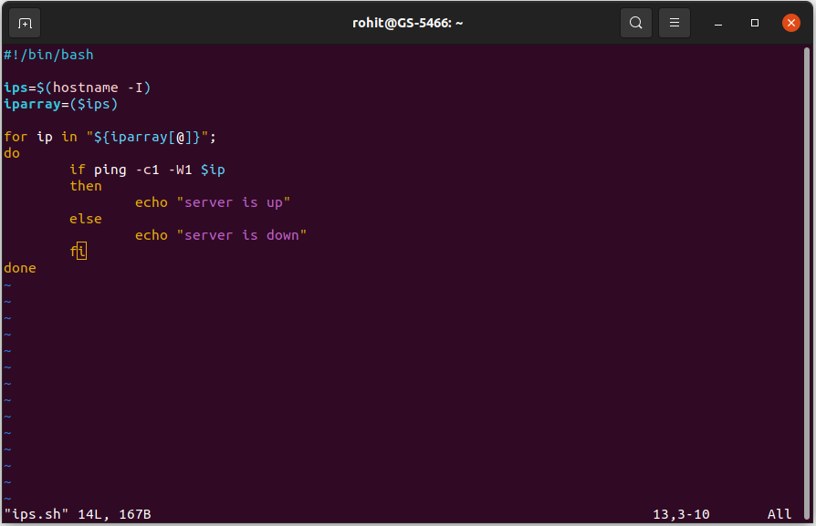

Slide 4
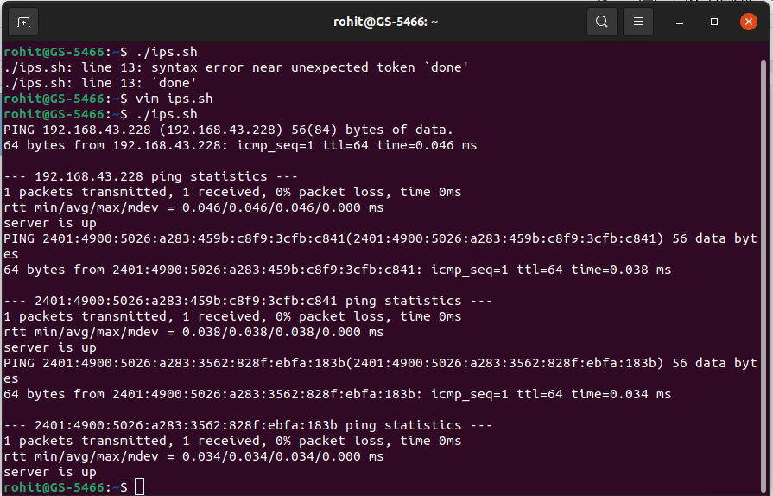

Slide 5
Get list of open ports of specified host.
To get status of ports,we can use nc command.nc stands for netstat.
it performs tests on ports and determines whether port is open or closed.
options:
-v:run result in verbose mode.
-z:scans open ports only,without transferring any data.
Syntax:nc -z -v ip_address port_range | grep succeeded
Notes:
‹#›

Slide 6
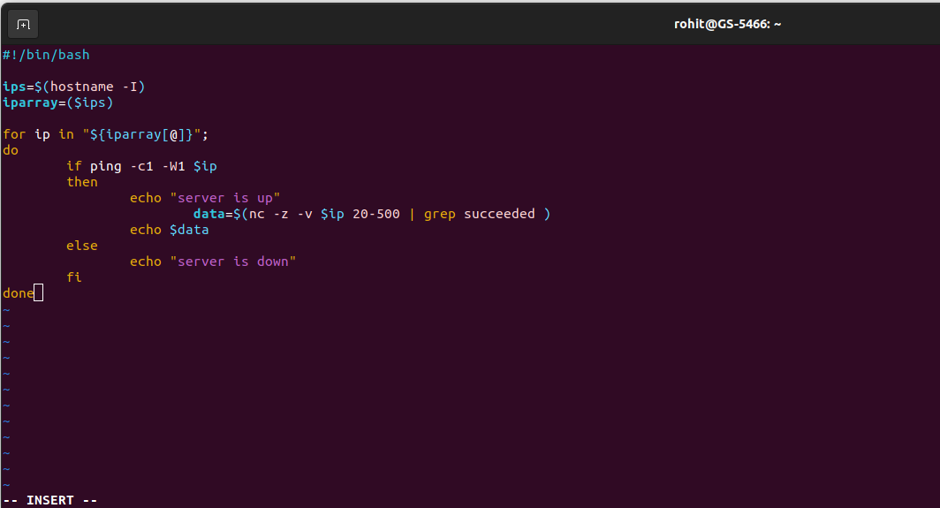

Slide 7
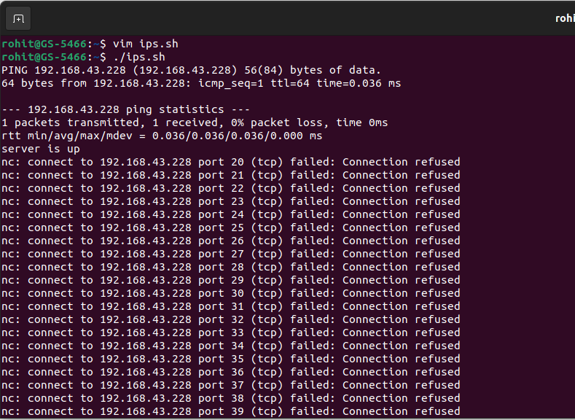

Slide 8
Show CPU utilization.
to get CPU utilization,top command will be used.it shows the active linux processes.
grep command is used to extract CPU related information and awk command prints the amount.
awk command extracts required data and using cut command,convert it into decimal value.
Syntax: top -b -n 1 | grep Cpu | awk ‘{print $8}’ | cut -f 1 -d “.”
Notes:
‹#›

Slide 9
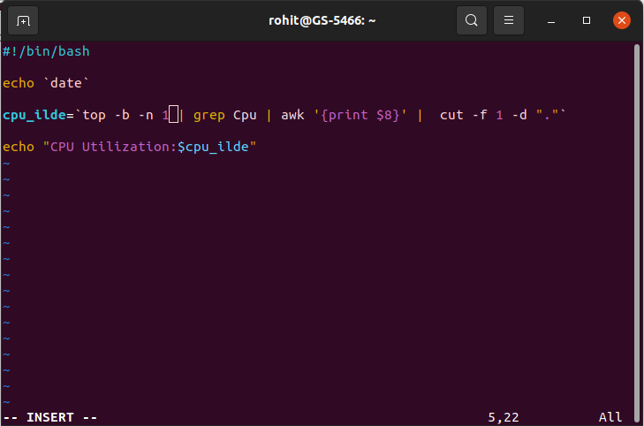

Slide 10
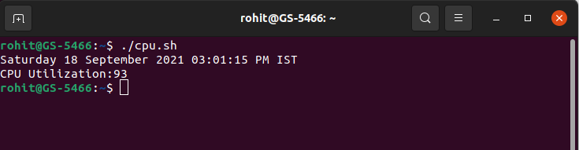

Slide 11
Show free RAM space.
to get free RAM memory space,free command is used.result of free command is piped to grep command
grep command is used to extract Memory related information and awk command prints the amount.
awk command extracts required data and add required parameters.
Syntax: free -m | grep “Mem” | awk ‘{print $4+$6}’`
Notes:
‹#›

Slide 12
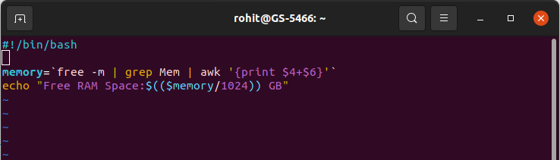
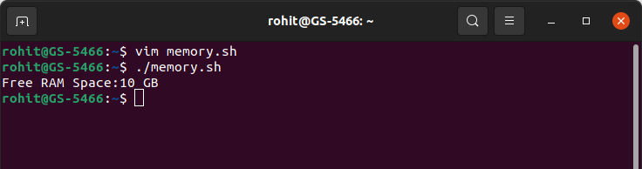

Slide 13
Show disk usage.
to get disk usage,df command is used.output of df command is passed to grep for extracting required data.
grep command is used to disk related information and awk command prints the amount.
Syntax: df -P | grep /dev | grep -v -E ‘(tmp|boot)’ | awk ‘{print $5}’ |
cut -f 1 -d “%”
Notes:
‹#›

Slide 14
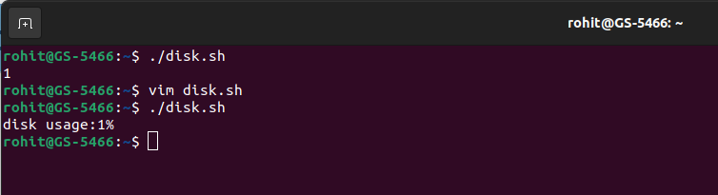
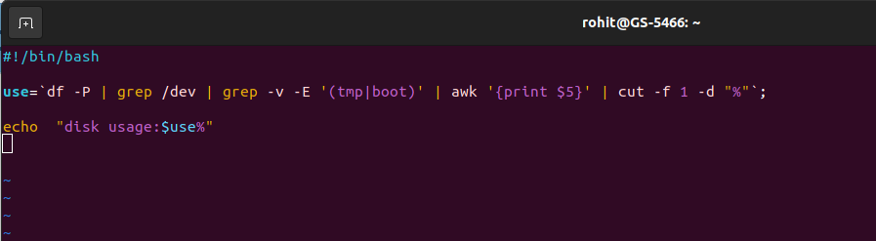

Slide 15
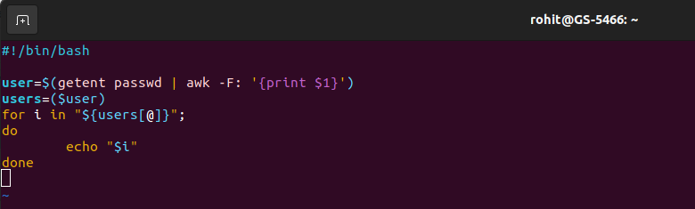
get existing users.
getent command is used to get all existing users in a system.
awk command filters result and print first name of user.
example:getent passwd | grep -F: ‘{print $1}’

Slide 16
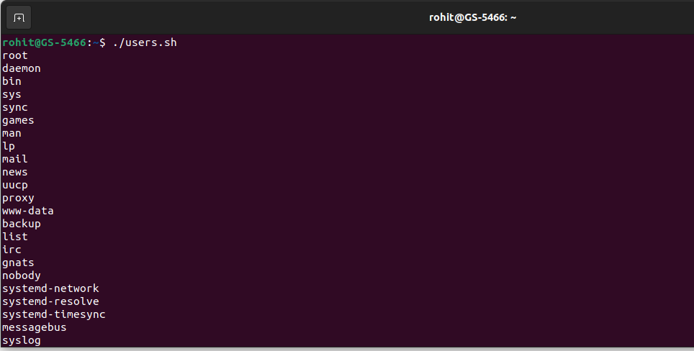

Slide 17
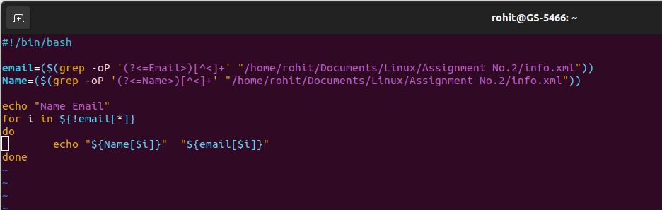
parse xml file and create html table.
firstly,parse the xml file using grep command and store result in data.txt.
write a script for html file fill table data by reading data.txt file.

Slide 18
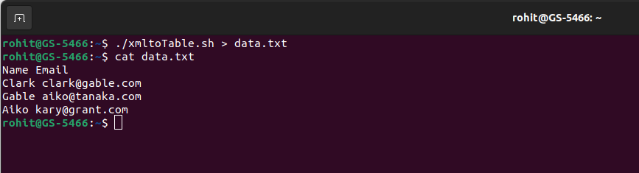
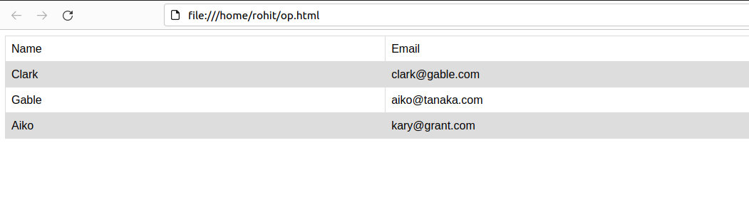

Slide 19
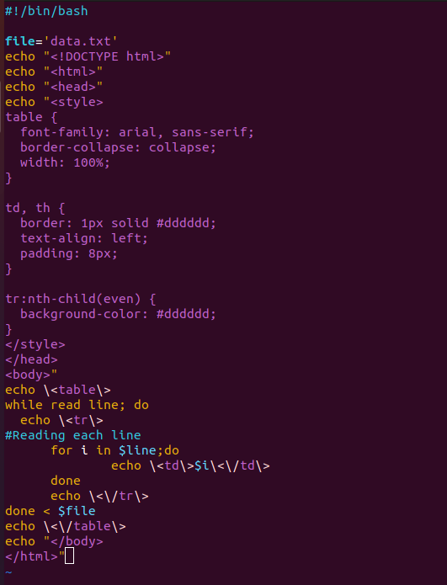
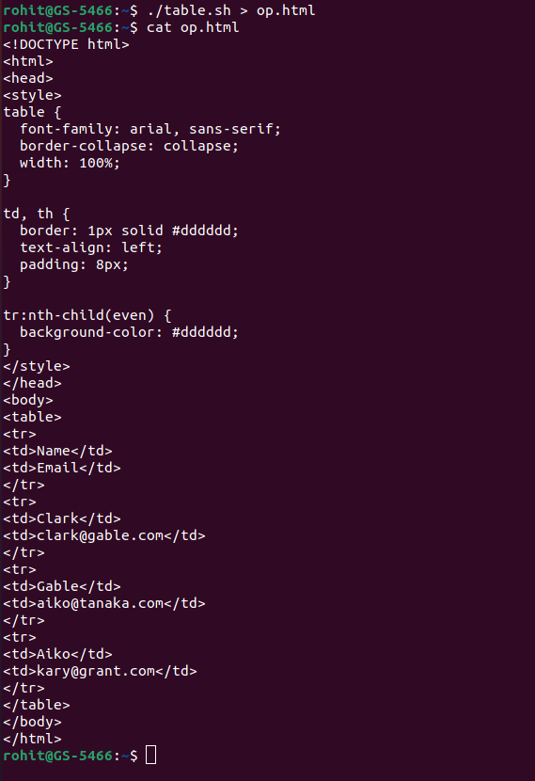

Slide 20

Thank You

